Slide 1
Lunar Phase Influence On Crime in Austin Texas
Rice-hou-data-pt-01-2021
Team: Jon Argoitia, Erin O'Brien, Gregory Talbott & Fatima Shami

Slide 2
8-Phases of the lunar cycle
When sunlight reflects off the near side, we call it a full Moon. The rest of the month we see parts of the daytime side of the Moon, or phases. These eight phases are, in order, new Moon, waxing crescent, first quarter, waxing gibbous, full Moon, waning gibbous, third quarter and waning crescent. The cycle repeats once a month (every 29.5 days).
Retrieved from https://solarsystem.nasa.gov/moons/earths-moon/lunar-phases-and-eclipses/ on March 11, 2021

Slide 3
Problem statement
Our project is to uncover patterns in criminal activity in Austin with the various moon phases. Covering data between 2014 to 2021. We'll examine relationships between types of crime and moon phase; crime rates and moon phase; and related questions, as the data admits.

Slide 4
Hypothesis and question(s)
H1: Incidents of in Austin, Tx increase as the lunar phase approachs the full moon phase
H0 : Incidents of in Austin, Tx do not increase as the lunar phases approach the full moon phase
Q1. Is there a positive relationship between major crimes and reported incidents over time (per day) ?
Q2. Is there a positive relationship between major crimes reported and nonviolent crimes reported by moon phase?
Q3. Is there a correlation between moon phase and assault, intoxication, and theft crimes?
Q4. Is there an increase in minor (stupid) crimes as the lunar phase approaches the full moon phase?

Slide 5
DATA Analysis
The crime data API was collected from https://data.austintexas.gov/Public-Safety/Crime-Reports/ for years 2014 to 2021
A .csv file was created for the moon phase data by putting the data collected for moon phase and time in excel and save from link https://www.calendar-12.com/moon_phases/

Slide 6
summary statistics

Slide 7
major crimes vs total number of reports for a day

Slide 8
graphical representation of moon phase cycle and number of crime reports by day

Slide 9
whisker plot of moon phase and crime to check for outliers

Slide 10
compare violent crime and nonviolent crime trends to see if one or the other changes with moon phase

Slide 11
assault and intoxication crimes and theft

Slide 12
Relationship between random minor crimes to see if people acting stupid increases

Slide 13
split out crimes for individual correlations to see if one in particular is driving trends

Slide 14
compare on annual and monthly basis

Slide 15
Comparing high crime holidays and full moon
Data was selected over 3 years (2015-2017) for four months with important holidays:
January –New Years
July – 4th of July
October - Halloween
December - Christmas
Data was analyzed to see if there was a correlation between the holidays, the full moon and crime reports

Slide 16
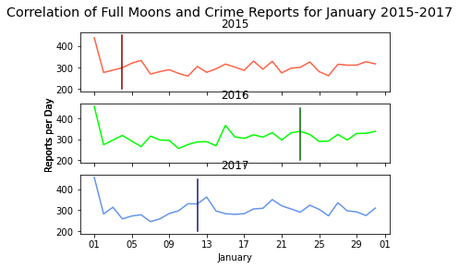
Comparing high crime holidays and Full moon
When comparting New Years (1st of January) the crimes reported were above 400
The days the full moon was out the crime rate reports varied randomly

Slide 17
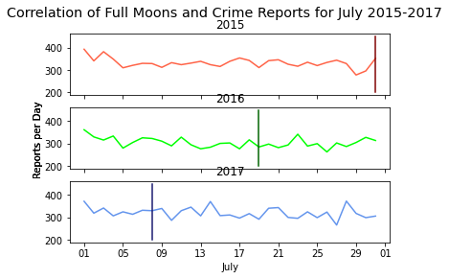
Comparing high crime holidays and full moon
There was no crime correlation for 4th of July (American independence day)
Crime reports were higher on the 1st of the month
The reported crimes varied on the days of full moon

Slide 18
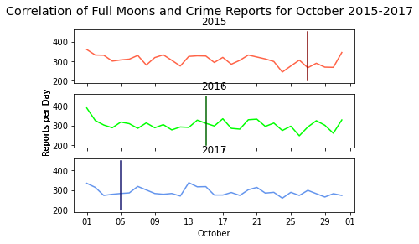
Comparing high crime holidays and full moon
When compared to Halloween (October 31st) there was a high crime trend for the years 2015 and 2016 but not 2017
Crimes reported were high on the first of the month
The days the full moon showed no trend

Slide 19
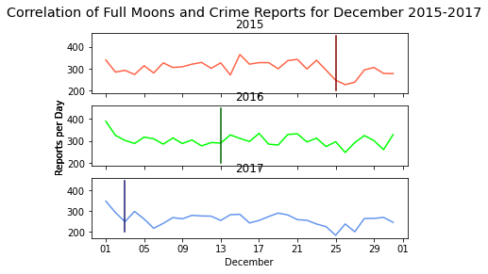
Comparing high crime holidays and full moon
Crime reports decreased around Christmas (25th December)
Crime reporting rates were higher on the 1st of the month
There was no relation between the full moon and crimes reported

Slide 20
Comparing high crime holidays and full moon
There was no correlation between the full moon and crime reported
Crimes reported were highest for 1st of January for all years chosen
There was an overall increase in the crime reports on the 1st of the months chosen
Crime reports decreased during Christmas time

Slide 21
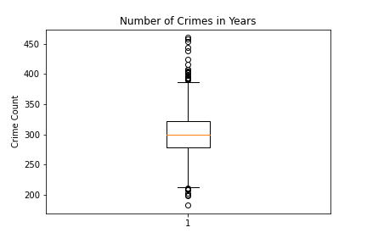
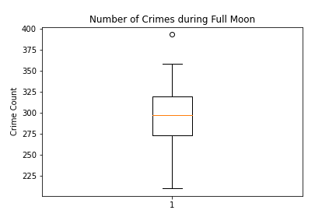
Comparing Overall Crime with Crime during full moon
When one compares the overall data for crime reports with just the crime reports for the full moon, we can see a clear see a similar mean in both crime reports
There is also more variance in the Number of Crimes in Years than the Number of Crimes during Full Moon, but that is more than likely due to the higher number of data for Crimes during Years

